Slide 1
Chapter P.1:
GRAPHS AND MODELS
HONORS CALCULUS/CALCULUS

Slide 2
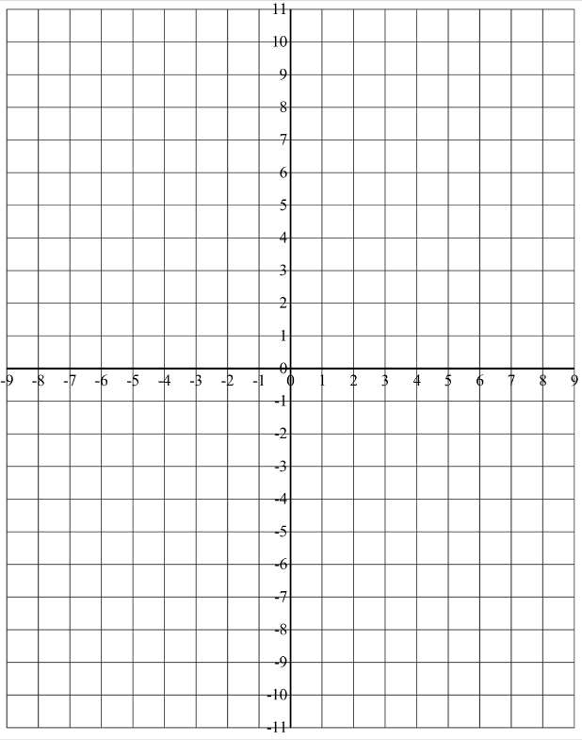
Sketching a Graph by Point Plotting
$$Sketch the graph of y=−2x−3$$
x
y
-2
-1
0
1
2

Slide 3
Sketching a Graph by Point Plotting
$$Sketch the graph of y=x^{2}−2$$
x
y
-2
-1
0
1
2

Slide 4
$$Sketch the graph of y=x^{3}$$

Slide 5
$$Sketch the graph of y=|x−2|$$

Slide 6
$$Sketch the graph of$$
$$y=\sqrt{x}$$
$$y=\sqrt{x+1}$$
$$y=\sqrt{x−2}$$

Slide 7
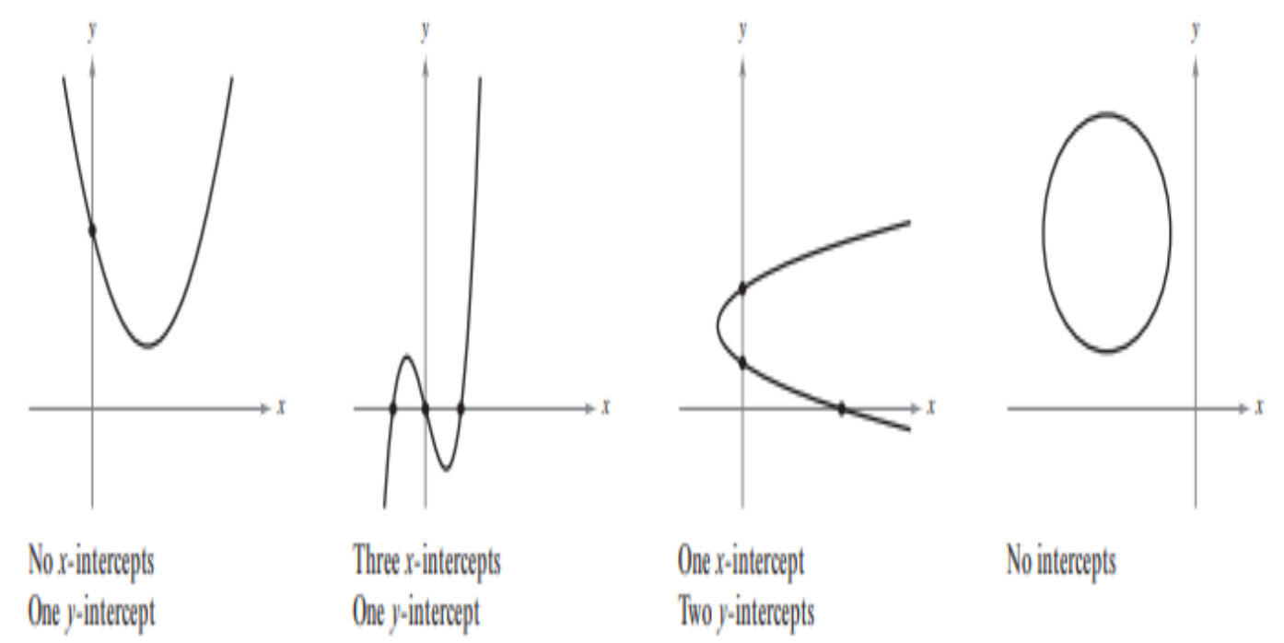
Finding x- and y-intercepts

Slide 8
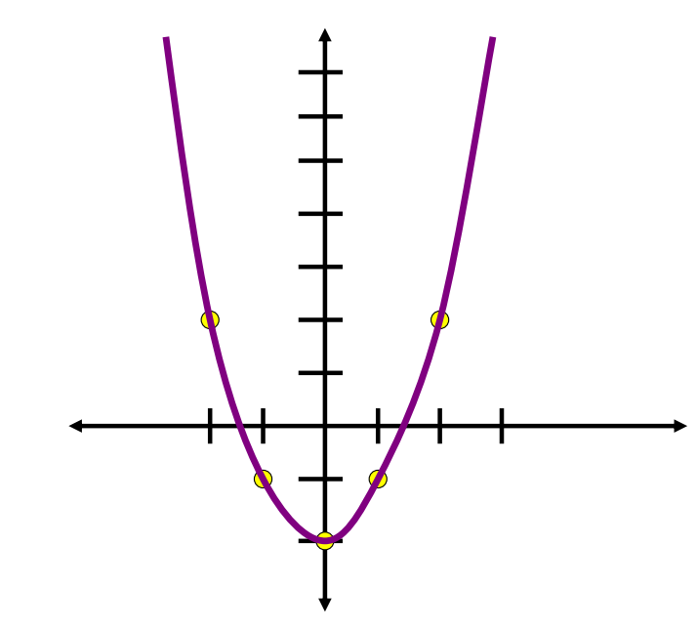
Finding x- and y-intercepts

Slide 9
Finding x- and y-intercepts

Slide 10
$$Find the x−and y−intercepts of the graph of$$
$$y=x^{3}−4x$$
To find the x-intercepts, let y be zero and solve for x.
To find the y-intercepts, let x be zero and solve for y.

Slide 11
Sketch the graph of the equation by identifying the intercepts.
$$y={−x}^{2}+1$$
To find the x-intercepts, let y = 0.
To find the y-intercepts, let x = 0.

Slide 12
Find the all points of intersection of the following graphs.
$$−x+3y=11$$
$$5x+y=9$$
$$x^{2}−y=3$$
$$x−y=1$$

Slide 13
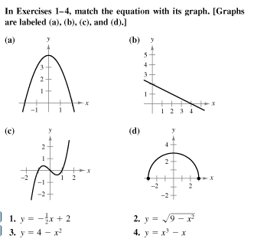
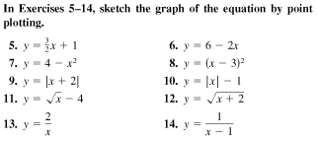

Slide 14
